Slide 1
Planned Parenthood of Illinois Abortion Services
All 18 Health Centers offer Medication Abortion (MAB) up to 11.0 weeks
 | PPIL Health Center | Gestational Limit for Procedural Abortion | Procedural Abortion Availability
Chicago | Austin
 | Englewood
 | Loop
 | Near North | 21 weeks 6 days | Tues through Sat
 | Rogers Park
 | Roseland | 17 weeks 6 days | Mon
 | Wicker Park
Suburban Chicago | Aurora | 21 weeks 6 days | Fri & Sat
 | Flossmoor | 21 weeks 6 days | Tues & Thurs
 | Orland Park
 | Waukegan | 17 weeks 6 days | Weds
Central & Southern Illinois | Bloomington
 | Carbondale | 15 weeks 6 days | Thurs through Sat
 | Champaign | 21 weeks 6 days | Tues through Thurs
 | Decatur
 | Ottawa
 | Peoria (temporarily closed)
 | Springfield | 17 weeks 6 days | Mon
TELEHEALTH | No-ultrasound MAB and direct-to-patient MAB (via mail) are available to qualifying patients.
Updated April 2024. Check ppil.org/providers for current info.

Slide 2
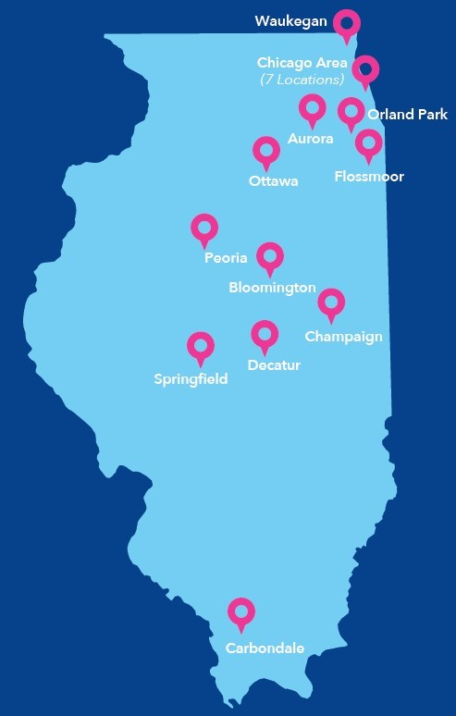
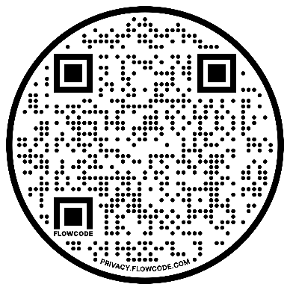
Provider
Chicago
Austin Health Center
5937 W. Chicago Ave.
Chicago, IL 60651
Englewood Health Center
6059 S. Ashland Ave.
Chicago, IL 60636
Loop Health Center
16 N. Wabash Ave., 5th floor
Chicago, IL 60603
Near North Health Center
1200 N. LaSalle St.
Chicago, IL 60610
Rogers Park Health Center
5725 N. Broadway
Chicago, IL 60660
Roseland Health Center
11250 S. Halsted St.
Chicago, IL 60628
Wicker Park Health Center
1152 N. Milwaukee Ave.
Chicago, IL 60642
Orland Park Health Center
14470 S. LaGrange Rd.
Orland Park, IL 60462
Waukegan Health Center
1601 N Lewis Ave.
Waukegan, IL 60085
Central & Southern Illinois
Bloomington Health Center
1319 N. Veterans Pkwy.
Bloomington, IL 61704
Carbondale Health Center
200 N. Emerald Ln.
Carbondale, IL 62901
Champaign Health Center
302 E. Stoughton St
Champaign, IL 61820
Decatur Health Center
3021 N. Oakland Ave.
Decatur, IL 62526
Ottawa Health Center
612 Court St.
Ottawa, IL 61350
Peoria Health Center
2709 N. Knoxville Ave.
Peoria, IL 61603
Springfield Health Center
601 N. Bruns Ln.
Springfield, IL 62702
Referral
Information
PPIL.ORG/PROVIDERS
877.200.PPIL
Suburban Chicago
Aurora Health Center
3051 E. New York St.
Aurora, IL 60504
Flossmoor Health Center
19831 Governors Hwy.
Flossmoor, IL 60422

